Slide 1

Introduction
Personal Introduction
Presentation Objective
REST API
Demo
Review
Conclusion

Slide 2
Personal Introduction
Presentation Objective
Name: KY Lim
Experience:
Programing: 4 mths ago in this GO lang course
HTML: never touch before, and not taught in this course
MySQL DB: abt 3 weeks ago taught how to setup
JSON: abt 3 weeks ago
Role in the team: REST API
Objective for this prezo:
Build a program to show achieving GO lang basic programming

Slide 3
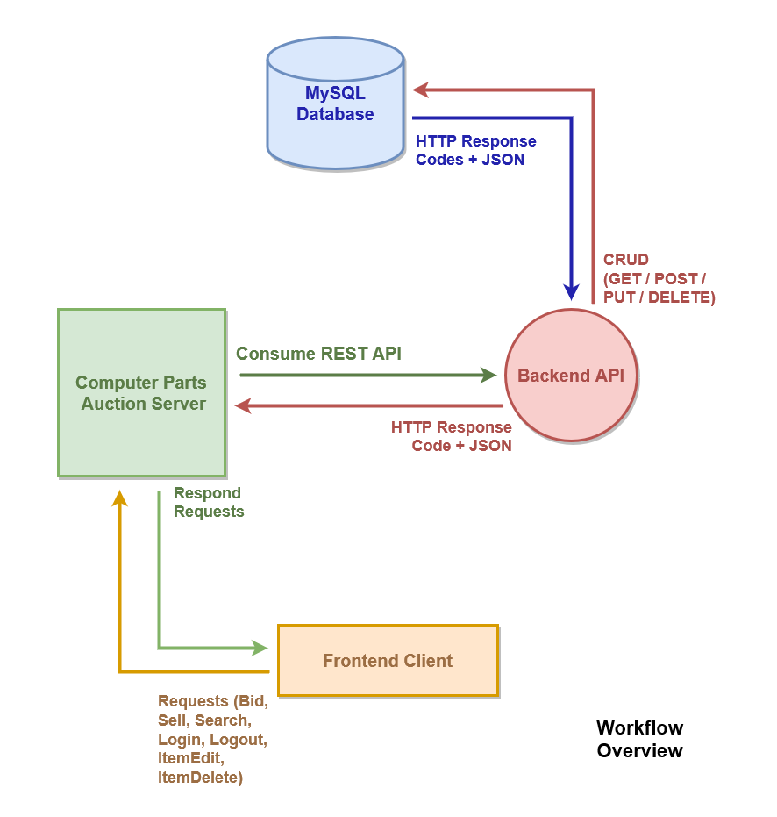


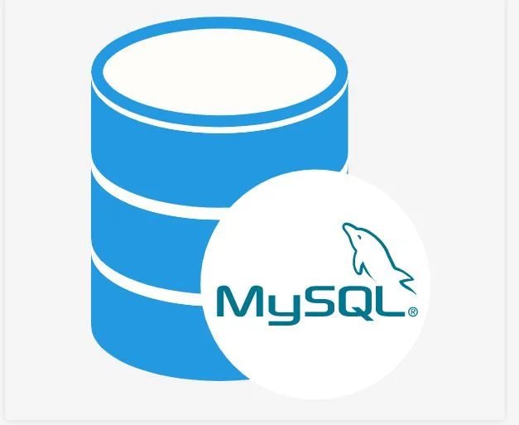

Conputer Auction System
REST API

Slide 4
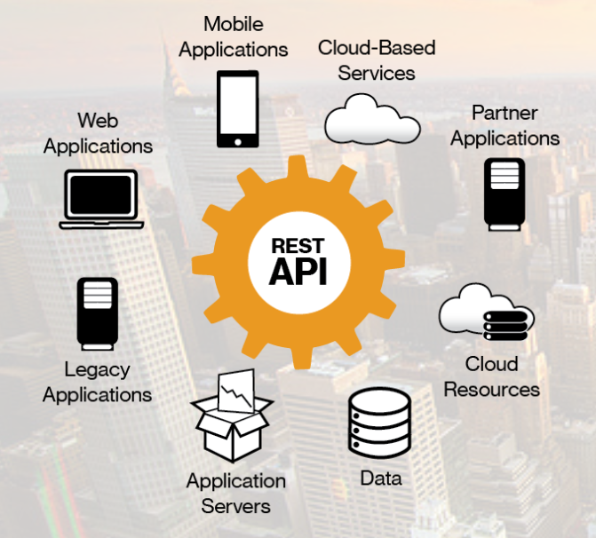
REST API
Integral part of the solution
planning for future integration

Slide 5
Demo
REST API main page
CRUD
-Retrieve user db without access key - error:
-Retrieve user & item db with access key
CRUD
-Add new item
-Check new Item info
-Add same item again - error
CRUD
-Update item
-Check updated Item info
CRUD
-Delete item
-Check deletion

Slide 6
Review
Basic requirement met for CRUD operation
Future Development
Near term:
1) Docker
-load balancing
-lower footprint and easier deployment for any needs
-fail over (high availability)
-redundancy
3) Caching of partial DB

Slide 7
Review
Future Development
Longer term:
1) integrate into corporate system management
-security: event management
2) functional management
-JWT authentication for other solution team integration
-implementation authentication server to handle JWT

Slide 8
Conclusion
Course objective met
More learning/knowledge needed for overall solution completeness
Thank you
Questions?
Notes:
what other methods other than using REST API
how to load balance API
JWTclient direct access to API consideration

